Slide 1

PHARMACY MANAGEMENT SYSTEM
SRM INSTITUTE OF SCIENCE AND TECHNOLOGY
FACULTY OF ENGINEERING AND TECHNOLOGY
DEPARTMENT OF COMPUTER SCIENCE AND ENGINEERING
18CSC303J – DBMS MINI PROJECT
Student(s) Name & Reg No.: PALADI JAYANTHSAI
RA2111003010584
Guide Name: Dr. A.M.J Muthu Kumaran

Slide 2
Review-1 Table of contents
Abstract
Introduction
Literature Survey
Inference from the survey
Objective of the Project
Architecture diagram
E-R Diagram

Slide 3
Abstract
The Pharmacy Management System presented in this mini-project offers a streamlined solution for managing drug inventory, customer records, and orders within a pharmacy setting. Built using Streamlit, a Python library for creating web applications, and SQLite for database management, the system provides functionalities for both customers and administrators. Administrators have access to broader functionalities including managing drug inventory, customer records, and orders. They can add, view, update, and delete drug entries, facilitating effective inventory management. Similarly, administrators can manage customer accounts by viewing, updating, or deleting customer records. The system also enables administrators to track orders placed by customers. Overall, this Pharmacy Management System offers an intuitive interface for both customers and administrators, enhancing the efficiency and organization of pharmacy operations.

Slide 4
Introduction:
In the fast-paced world of pharmacy management, efficient organization and seamless operations are paramount. Our mini-project introduces a comprehensive Pharmacy Management System designed to streamline key processes within a pharmacy setting. Leveraging the power of Python libraries such as Streamlit for web application development and SQLite for database management, our system offers a user-friendly interface for both customers and administrators. This presentation will provide an overview of our Pharmacy Management System, highlighting its key features, functionalities, and the benefits it offers to pharmacy operations. From managing drug inventory to facilitating customer orders, our system aims to optimize efficiency and enhance the overall experience for both pharmacy staff and customers.
Join us as we delve into the details of our Pharmacy Management System, showcasing its capabilities and demonstrating how it can revolutionize pharmacy management in the modern age.

Slide 5
Literature Survey
Existing System
The Existing pharmacy management systems (PMS) are designed to streamline and automate tasks in a pharmacy setting, improving efficiency and patient care. These systems typically include a database for storing information about medications, patients, and prescriptions. They also provide a user interface for pharmacists to manage inventory, process prescriptions, and track patient profiles.
Many existing pharmacy management systems also include online booking systems that allow customers to book medicines from their computers or mobile devices. These systems often integrate with payment gateways to handle payments and fees.
In addition to managing bookings and payments, pharmacy management systems can also include monitoring systems for tracking resource usage but doesn’t shows the drug capacity. This allows to have differ logins for admin & customer .
Overall, the goal of a pharmacy management system is to streamline operations and improve the overall experience for both admins and customers. By automating many of the tasks associated with running a campground, these systems can help admins focus on providing a highest performance or interaction for their customers.

Slide 6
Literature Survey
COMPARISON OF EXISTING VS PROPOSED SYSTEM
In comparing existing and proposed pharmacy management systems, several factors come into play:
Integration: New pharmacy management systems may be designed to integrate with a wider range of technologies and systems than existing systems. For example, new systems may integrate with mobile apps, IoT devices, and social media platforms.
Flexibility: New pharmacy management systems may be more flexible in terms of customizability and scalability. This can allow pharmacy owners and managers to tailor the system to their specific needs and to grow the system.
User Interface: New pharmacy management systems may have a more user-friendly and intuitive interface than existing systems. This can make it easier for managers and admins to navigate the system and perform tasks more efficiently.
Automation: New pharmacy management systems may offer more automation capabilities than existing systems. For example, they may automate processes such as check-in and check-out and resource management.
Cost: New pharmacy management systems may be more cost-effective than existing systems, as they may offer more efficient processes and require less maintenance and manual labor.
Overall, new pharmacy management systems may offer a range of benefits over existing systems, including increased efficiency, flexibility, and cost savings. However, it is important to carefully evaluate the specific features and functionality of any new system before making a decision to switch from an existing system.

Slide 7
Inference from the survey
Based on the literature survey comparing existing and proposed pharmacy management systems, several key inferences can be drawn that highlight the potential advantages and considerations of adopting new technologies in pharmacy management. These inferences can serve as valuable insights, emphasizing the evolution and future direction of pharmacy management systems. Here are the inferences you might consider including in your review:
Integration with Emerging Technologies: Modern pharmacy management systems are designed to seamlessly integrate with a broader spectrum of technologies compared to their predecessors. This includes compatibility with mobile applications, Internet of Things (IoT) devices, and social media platforms, enhancing the scope of services pharmacies can offer and improving patient engagement.
Enhanced Flexibility and Scalability: The proposed systems are highlighted for their superior flexibility and scalability, which are crucial for adapting to the changing dynamics of the pharmacy industry. This adaptability allows pharmacies to customize features according to their specific operational needs and scale the system as the business grows, ensuring longevity and relevance of the management system.

Slide 8
3.Advanced Automation Features: The inclusion of advanced automation capabilities in new systems, such as automated check-ins, check-outs, and resource management, can drastically reduce manual tasks. This not only streamlines pharmacy operations but also allows staff to allocate more time to patient care and other critical tasks, enhancing overall productivity and service quality.
4.Cost-Effectiveness: Despite the initial perception that newer systems might be more expensive, the literature survey suggests that new pharmacy management systems can be more cost-effective in the long run. By optimizing operational efficiency, reducing the need for manual labor, and decreasing the likelihood of errors, pharmacies can achieve significant cost savings.
5.Lack of Drug Capacity Monitoring in Existing Systems: A notable limitation of existing systems is their failure to include features for monitoring drug capacity. The proposed systems could address this gap by incorporating inventory management features that provide real-time insights into drug availability, helping to prevent stockouts and overstocking.
In conclusion, the transition from existing to new pharmacy management systems offers numerous benefits, including enhanced integration with modern technologies, greater system flexibility, improved user interfaces, advanced automation, and cost savings.

Slide 9
Objective of Project
The primary objective of our Pharmacy Management System mini-project is to develop a comprehensive solution that addresses key challenges faced in pharmacy operations. Our objectives include:
Efficient Drug Inventory Management: Develop a system that enables pharmacy staff to easily add, view, update, and delete drug entries, ensuring accurate tracking of drug inventory levels and expiry dates.
Seamless Customer Management: Implement functionalities for managing customer accounts, including registration, authentication, and the ability to view, update, or delete customer records.
Streamlined Order Processing: Enable customers to place orders for desired drugs with ease, specifying the quantity required, and provide administrators with tools to track and manage orders efficiently.
User-Friendly Interface: Design an intuitive user interface that is easy to navigate for both customers and administrators, ensuring a positive user experience and promoting system adoption.
Security and Data Integrity: Implement robust authentication mechanisms to ensure secure access to customer-specific data, and employ database management techniques to maintain data integrity and reliability.

Slide 10
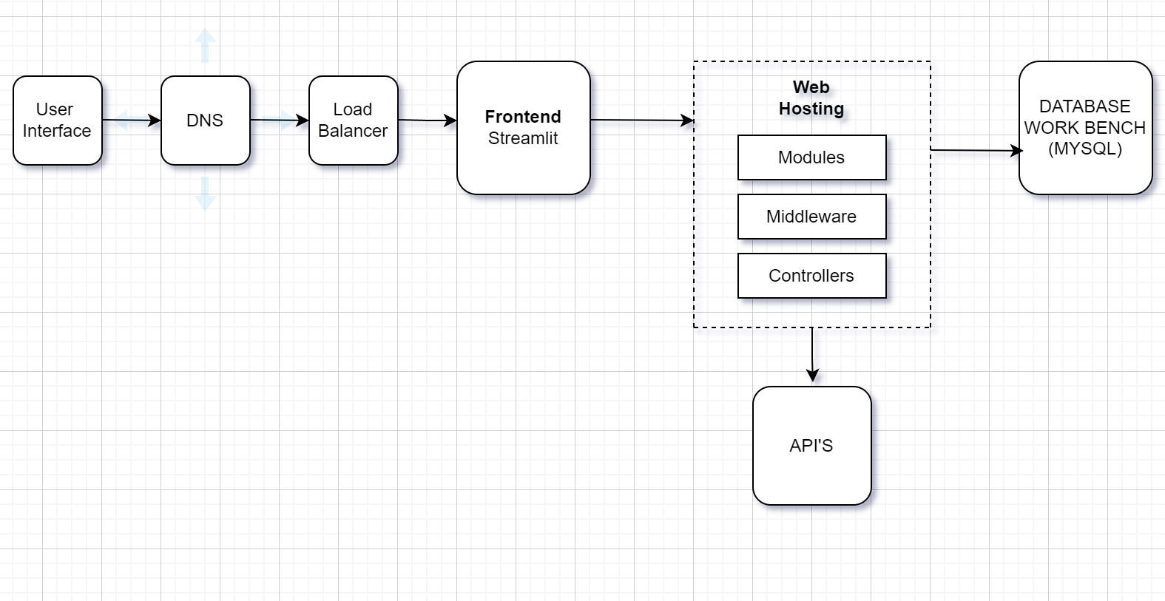
Architecture Diagram
The primary objective of our Pharmacy Management System mini-project is to develop a comprehensive solution that addresses key challenges faced in pharmacy operations. Our objectives include:
Efficient Drug Inventory Management: Develop a system that enables pharmacy staff to easily add, view, update, and delete drug entries, ensuring accurate tracking of drug inventory levels and expiry dates.
Seamless Customer Management: Implement functionalities for managing customer accounts, including registration, authentication, and the ability to view, update, or delete customer records.
Streamlined Order Processing: Enable customers to place orders for desired drugs with ease, specifying the quantity required, and provide administrators with tools to track and manage orders efficiently.
User-Friendly Interface: Design an intuitive user interface that is easy to navigate for both customers and administrators, ensuring a positive user experience and promoting system adoption.
Security and Data Integrity: Implement robust authentication mechanisms to ensure secure access to customer-specific data, and employ database management techniques to maintain data integrity and reliability.

Slide 11
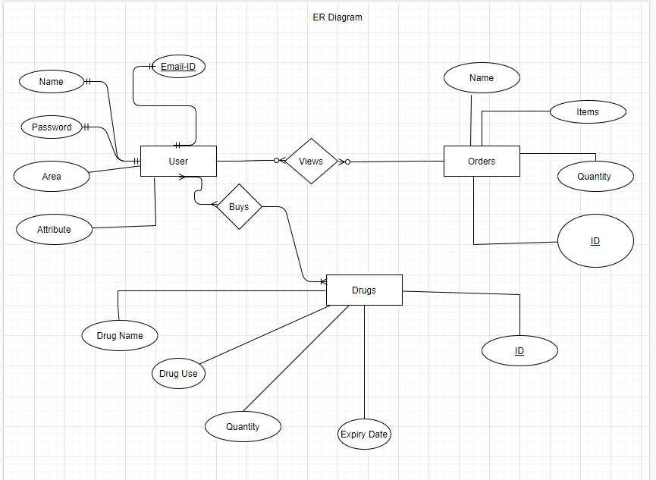
ER - Diagram

